Slide 1
The css box model
Explanation of the box model
Sizing and spacing elements
Setting borders and backgrounds
V. Starkey
Computer Science & Engineering
Wright State University

Slide 2
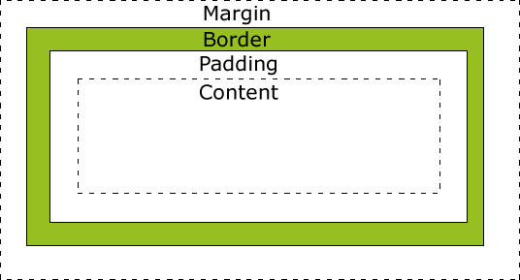
What is the box model?
Elements are represented as a rectangular box.
The width and height are based on the size of the content.
Padding – The space around the content of the element, inside the border.
Margin – The space around the element, outside the border.
Further reference: http://www.w3.org/TR/CSS21/box.html
Notes:
http://www.w3.org/TR/CSS21/box.html

Slide 3
Overall width and height of a box
Width = left margin + left border + left padding + width + right padding + right border + right margin
Height = top margin + top border + top padding + height + btotom padding + bottom border + bottom margin

Slide 4
Setting size of content area
Properties for setting size:
width, height, min-width, min-height, max-width, max-height
Use fixed (px) or relative units (em or %)
width % - based on the containing block (parent element)
width em – based on font size
height % - based on initial containing block (which is auto unless specified; % of auto is always auto)
height em – based on initial containing block
See width and height demo
Default is auto (width of overall box is 100% of containing block)

Slide 5
Setting margins
Properties for setting margins:
margin-top, margin-right, margin-bottom, margin-left, margin
margin may be used as shorthand:
margin: 10px; /* sets all margins to 10 px */
margin: 10px, 5px; /* sets top and bottom margins to 10px,
sets right and left margins to 5px; */
margin: .5em 0 .25 em; /* sets top margin to .5 em,
left and right margins to 0,
bottom margin to .25 em */
em is relative to font size; % is relative to parent container

Slide 6
Margin collapse
Occurs whenever two top or bottom margins are touching
Rather than the sum the margins, the larger one is used and the smaller margin is ignored (if equal, just one is used)
The largest negative margin (if any) will be subtracted from the “normal” calculated collapsed value
Collapsing margins between parent and child elements can be avoided by applying padding or border between them.
http://www.sitepoint.com/web-foundations/collapsing-margins/
http://www.w3.org/TR/CSS21/box.html#collapsing-margins
https://developer.mozilla.org/en-US/docs/Web/CSS/CSS_Box_Model/Mastering_margin_collapsing

Slide 7
Setting padding
Properties for setting padding:
padding-top, padding-right, padding-bottom, padding-left, padding
padding may be used as shorthand:
padding: 10px; /* sets all paddings to 10 px */
padding: 10px, 5px; /* sets top and bottom paddings to 10px,
sets right and left paddings to 5px; */
padding: .5em 0 .25 em; /* sets top padding to .5 em,
left and right paddings to 0,
bottom padding to .25 em */
em is relative to font size; % is relative to parent container

Slide 8
Setting borders
Properties for setting padding:
border-top, border-right, border-bottom, border-left, border
border: [width] [style] [color]
border-side: [width] [style] [color] //side may be top, bottom, left, right
border-width: specify a relative or absolute value for all or for each side
border-style: specify one of these values for all or for each side:
dotted, dashed, solid, double, groove, ridge, inset, outset, none
border-color: specify a color for all or for each side
border-side-width: set a width for the specified side
border-side-style: set a style for the specified side
border-side-color: set a color for the specified side

Slide 9
Other settings
Border:
border-radius: specify a value for all or each side
box-shadow: horizontalOffset verticalOffset blurRadius spread color;
Background:
background: [color] [image] [repeat] [attachment] [position];
Each background property may be set specifically (background-color, background-image, background-repeat, background-attachment, background-position)
See examples on page 189 of Murach text

